Slide 1
Making Your First Game
Kat Harris
Microsoft
@KatVHarris

Slide 2

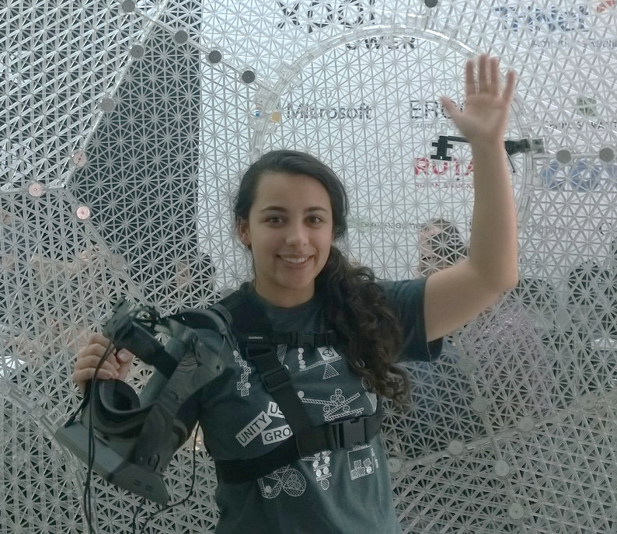
Katherine (Kat) Harris
Twitter: @KatVHarris
Blog: http://kaharri.com
Email: kaharri@Microsoft.com
GitHub:
https://github.com/KatVHarris/
Notes:
ME
GitHub
Unite
AUDIENCE
Now before we get to that I wanted to talk to you I wanted to tell you a little about myself and why I wanted to talk to you about this topic. As I mentioned before I’m an evangelist at Microsoft. Does anyone know what that is? It means that I get to play with cool technology and gamify almost anything I can get my hands on. As well as teaching others how to do the same. So everything I talk about will be released on my blog next week. And the base project for what I do is on github. I use that project as a simple Unity game.
I recently made a Kinect and Oculus integrated infinite runner. And after I completed it I wanted to release it into the store. But before I could I went to Unite Unity’s Dev conference in Boston. I learned about there new analytics and ads systems. And how the pay off of using these sytems was so large with virtual no overhead. So that’s what I’m going to show you today.

Slide 3

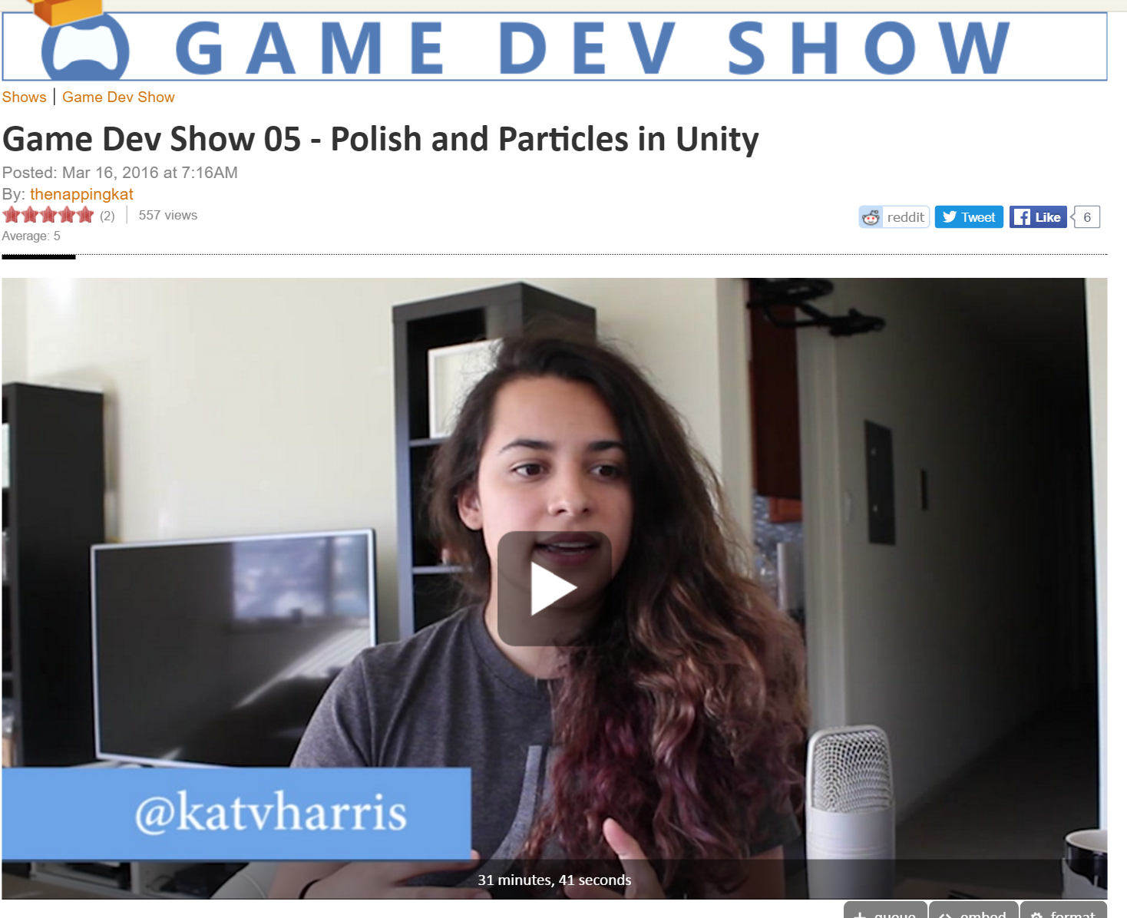

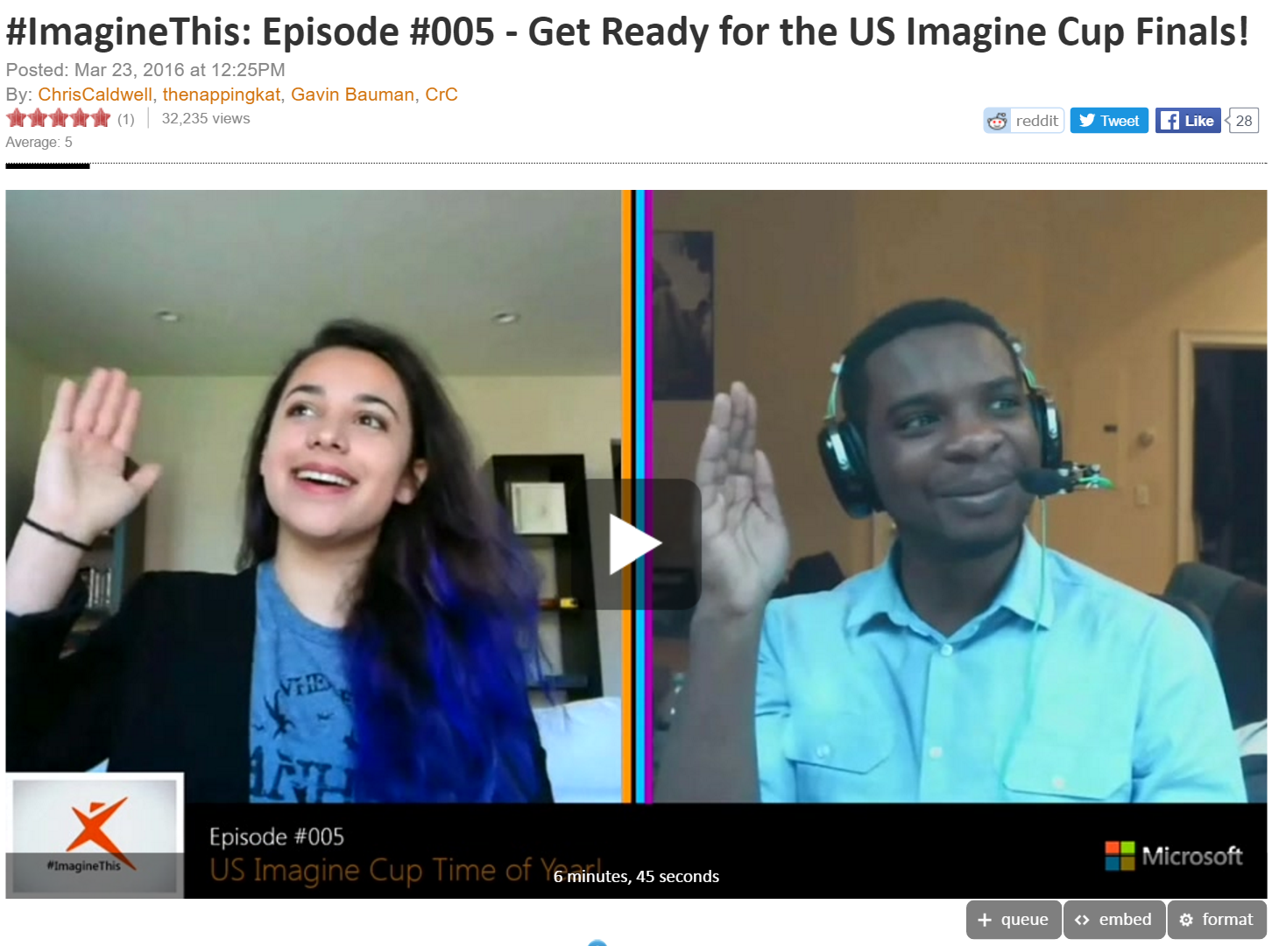
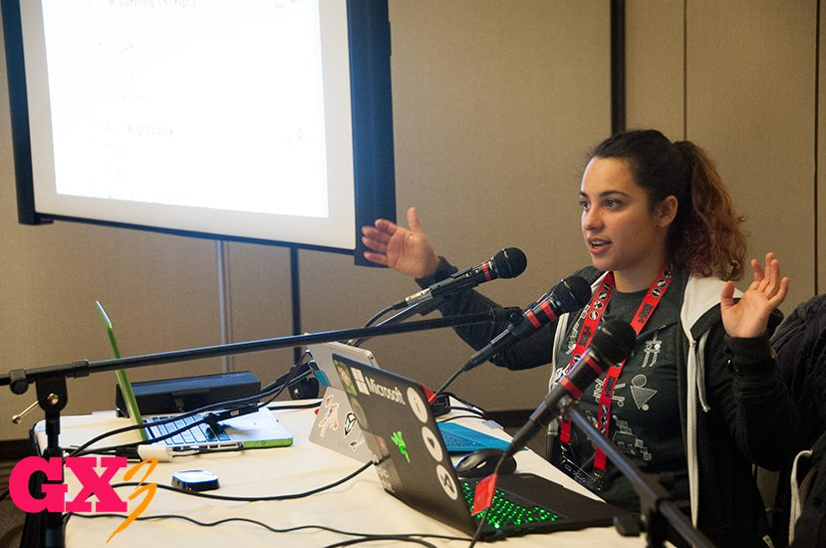

2015

Slide 4





Game Engines

Slide 5
Unity Editor
Layout
Project
Hierarchy
Scene
Game
Inspector
Navigation and Mouse Controls
Project Organization

Slide 6
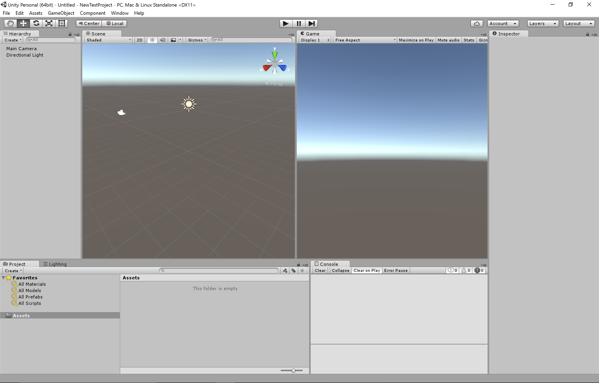

Slide 7
Importing Assets
Assets>Import Unity Assets
Characters
Environments

Slide 8
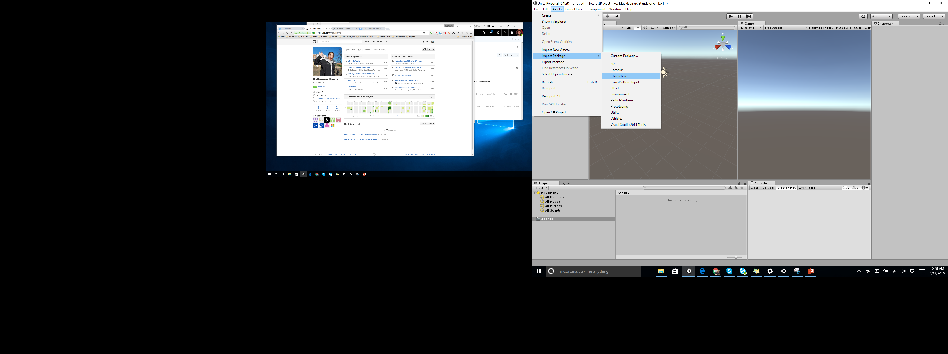

Slide 9
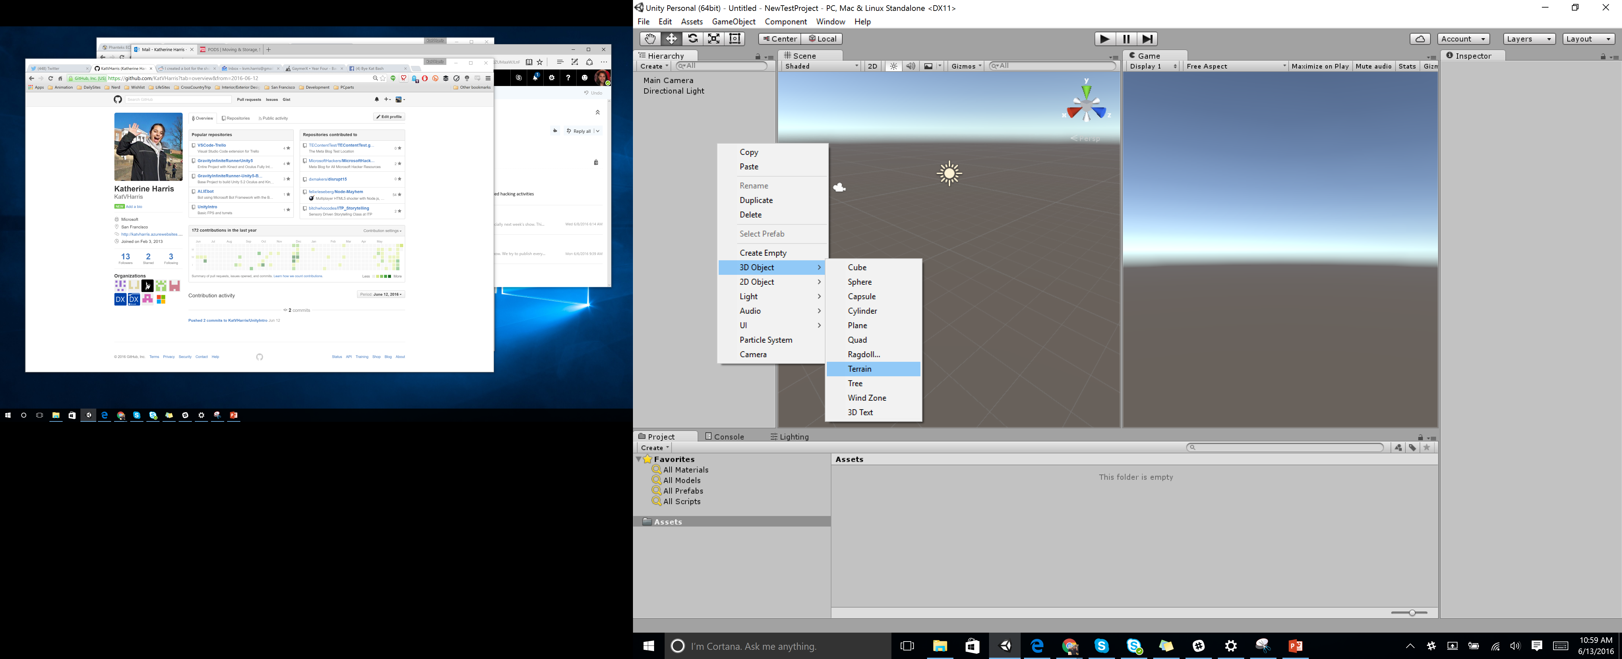
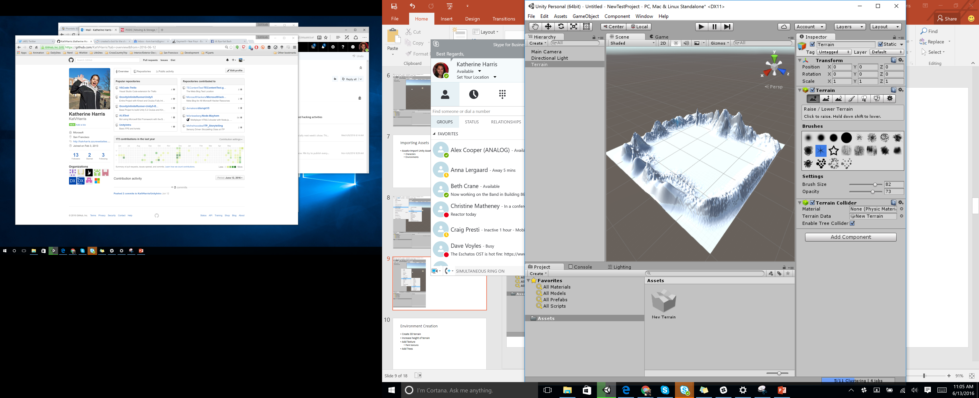

Slide 10
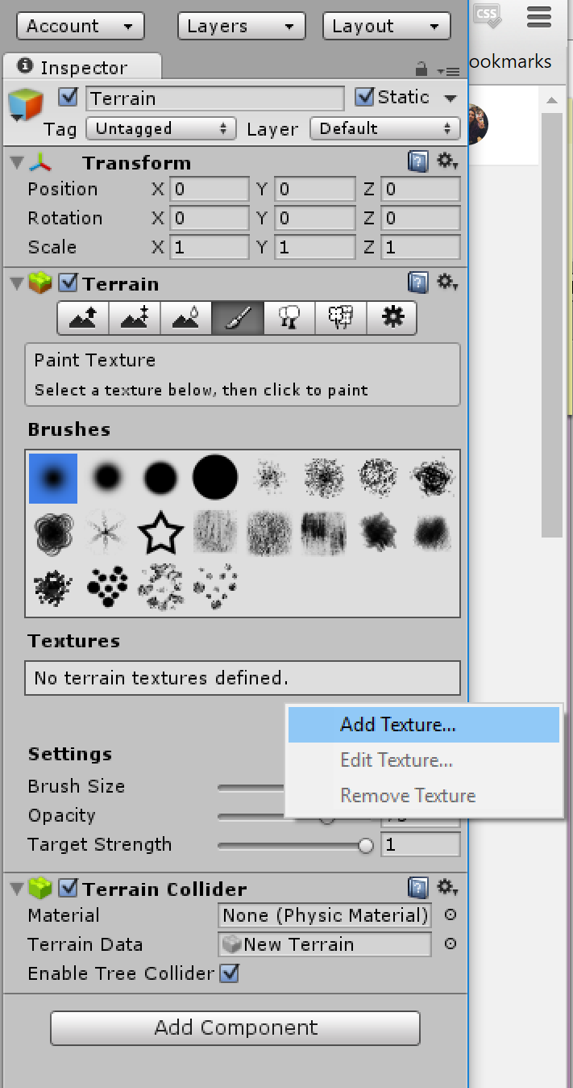
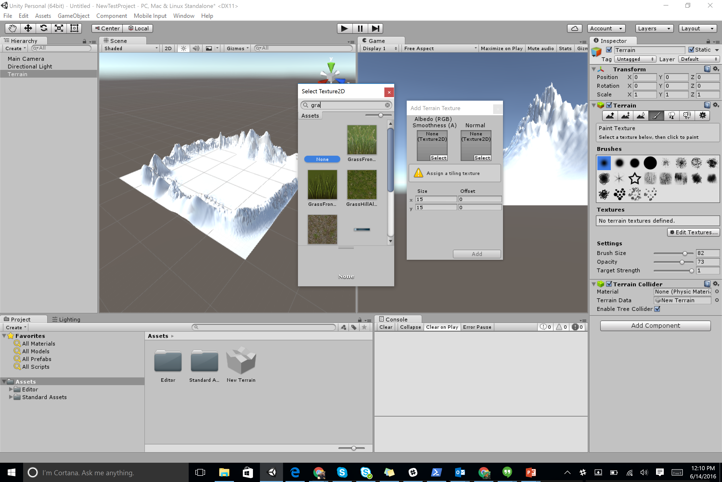
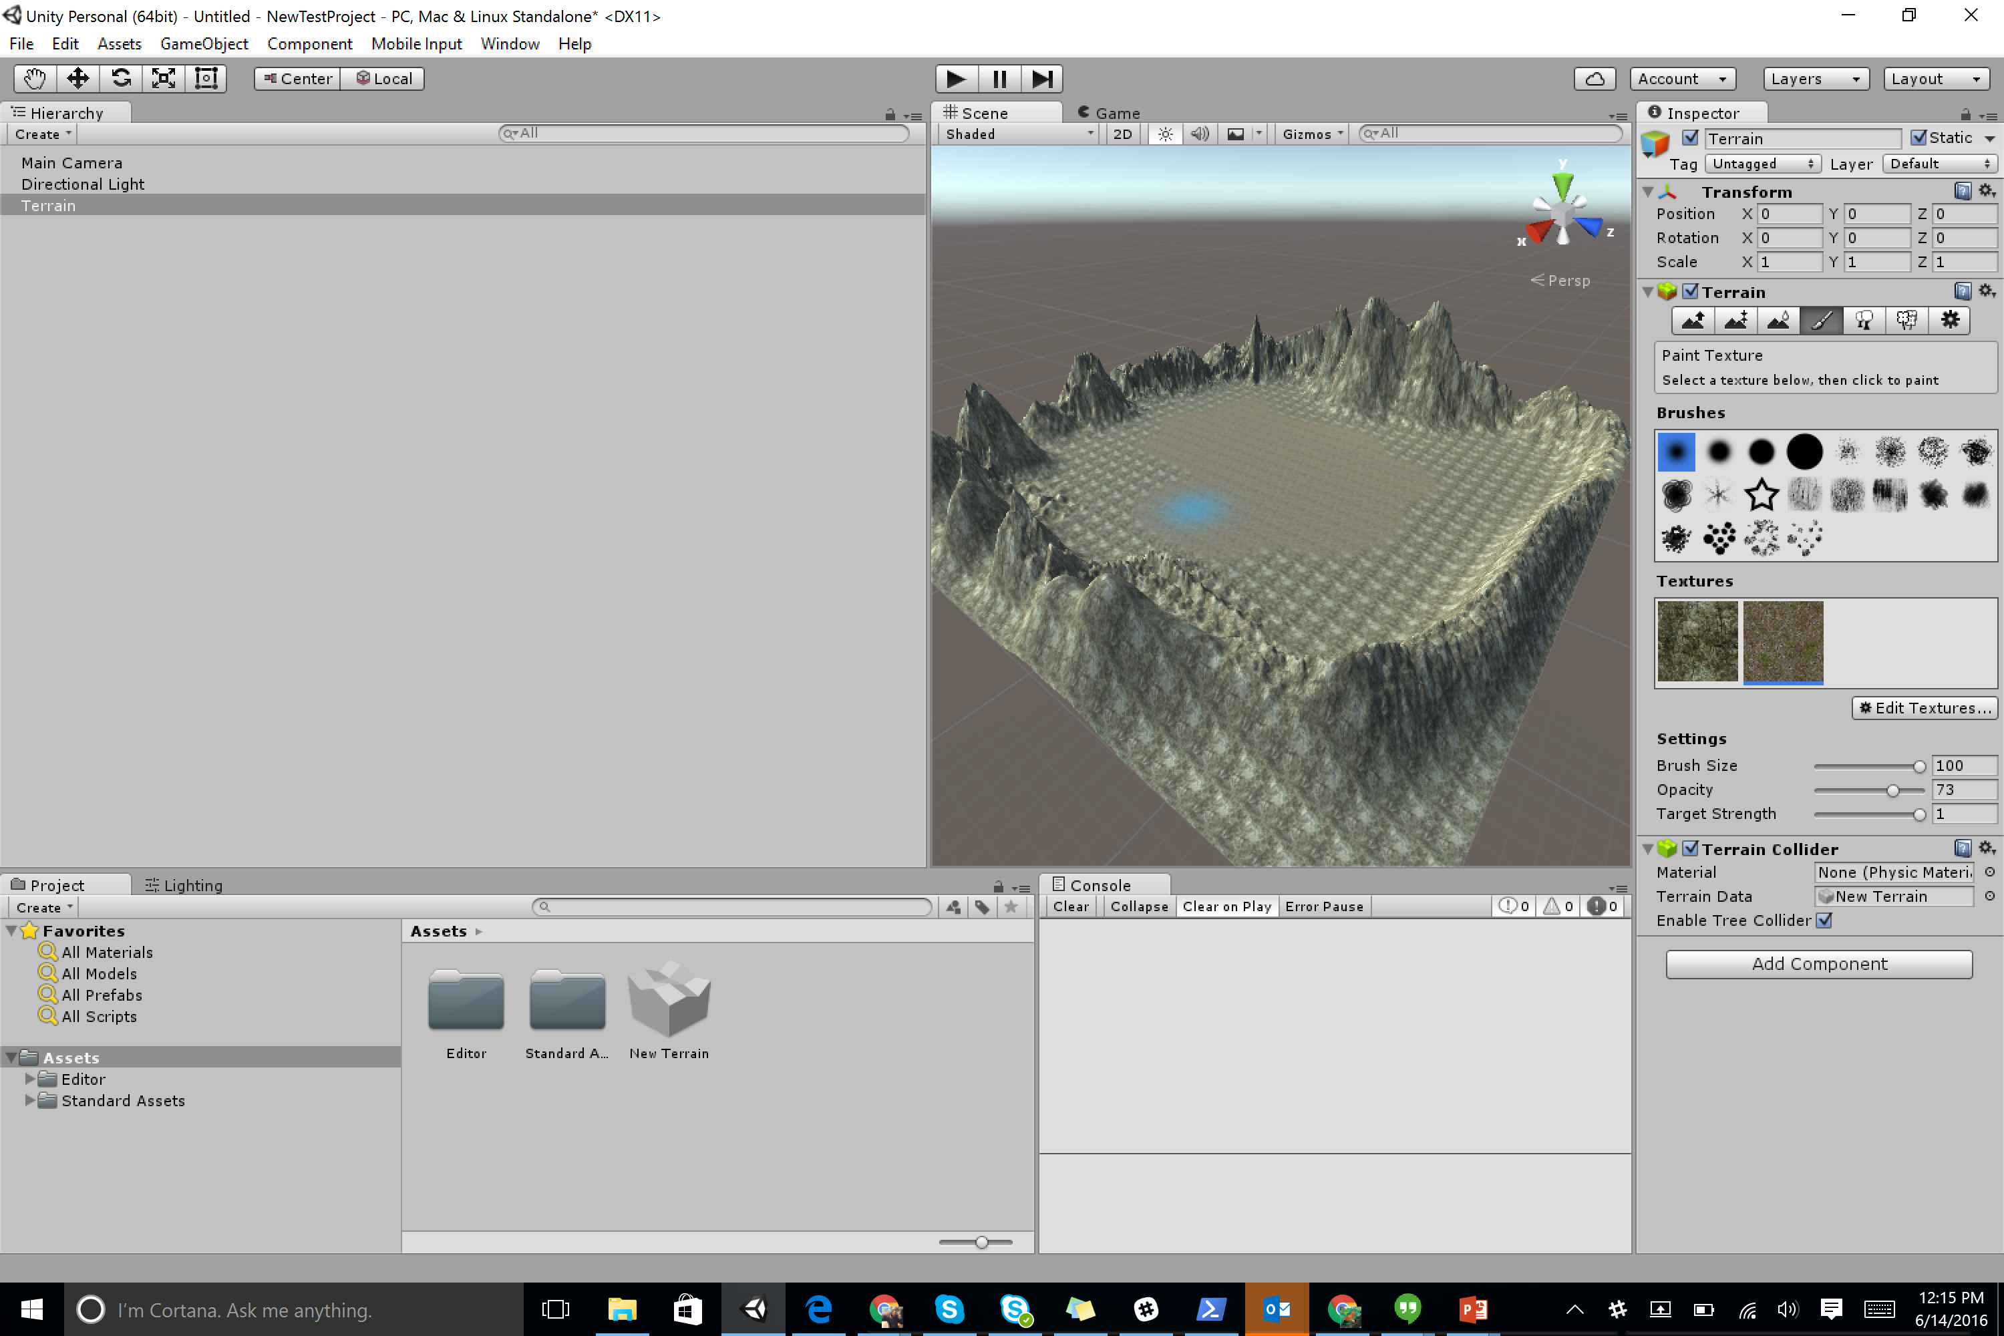

Slide 11
Environment Creation
Right Click in Hierarchy
Create > 3D > Terrain
Increase height of terrain
Click Brush > Edit Texture > Add Texture
Click and drag on Terrain
Click Flower > Edit Texture > Add Tree
Click and drag on Terrain

Slide 12
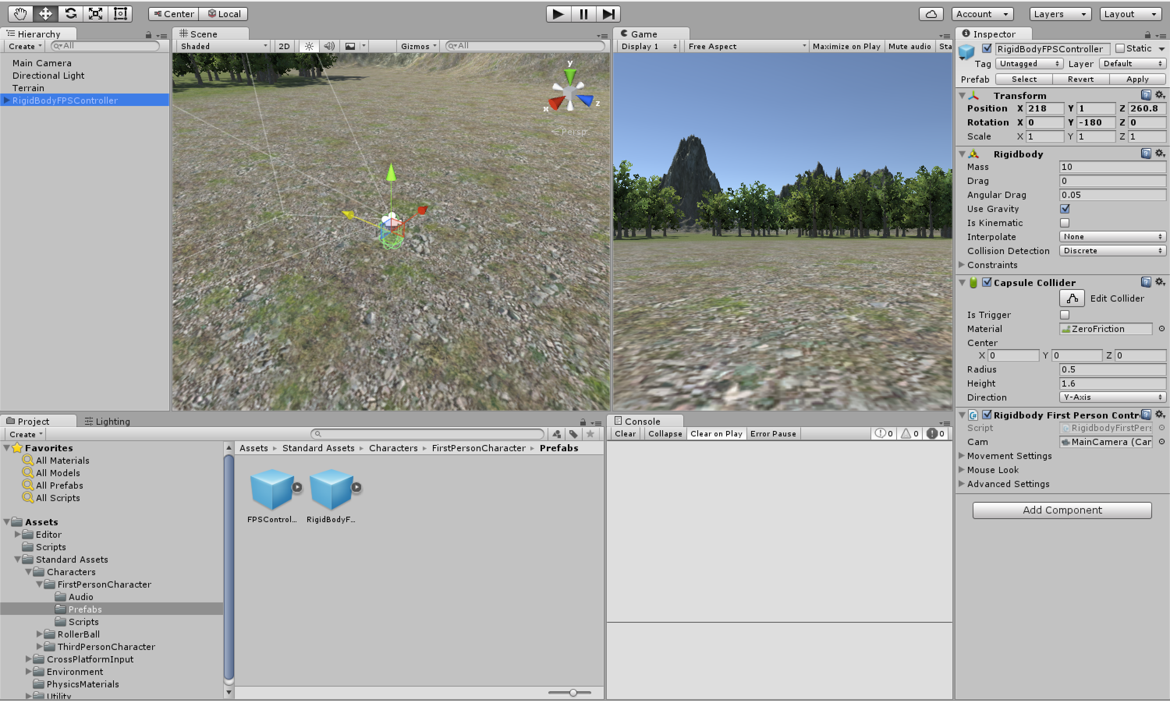

Slide 13
Prefabs – Adding Player Character
Project Folder
Click and drag the First Person Controller Prefab into the Hierarchy
Move the character to the center of Terrain
Click Play

Slide 14
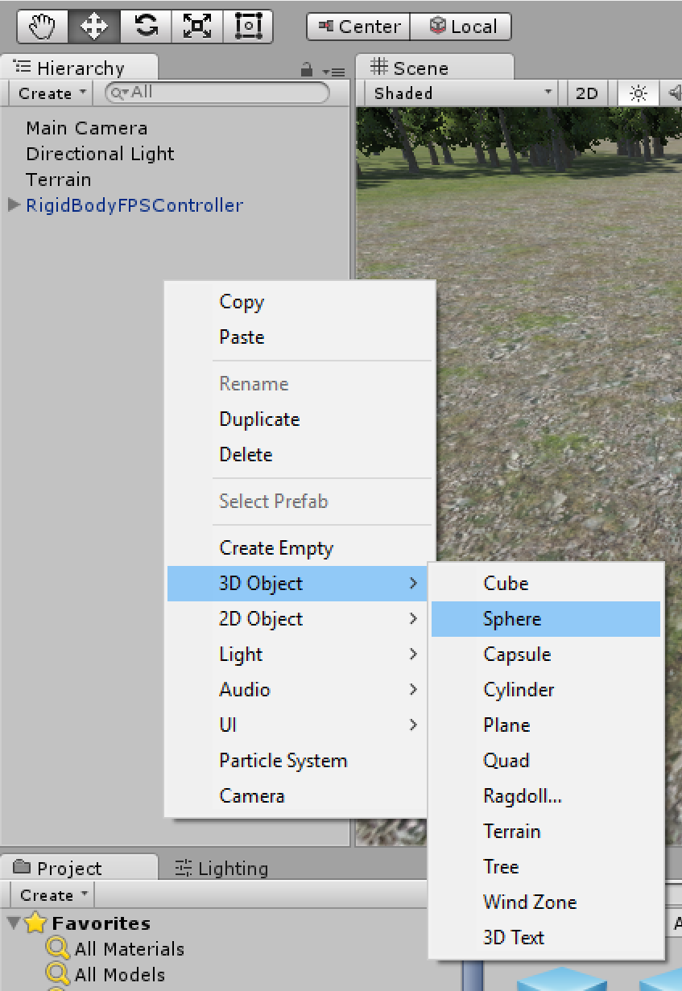
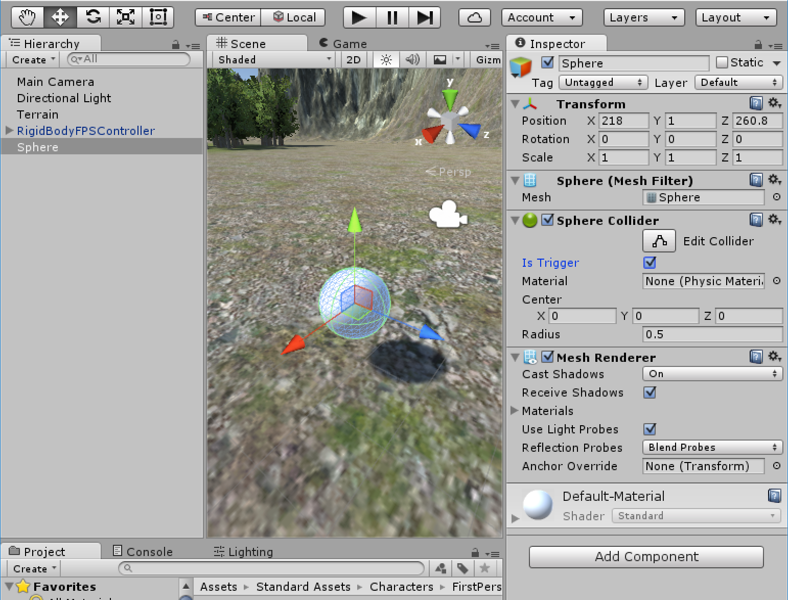

Slide 15
Object Interaction
Create New 3D Sphere Object
Add Player Tag to Player Object
Click IsTrigger

Slide 16
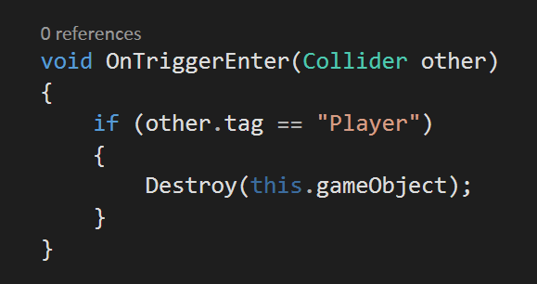
Trigger Object
Click isTrigger
Add code:

Slide 17
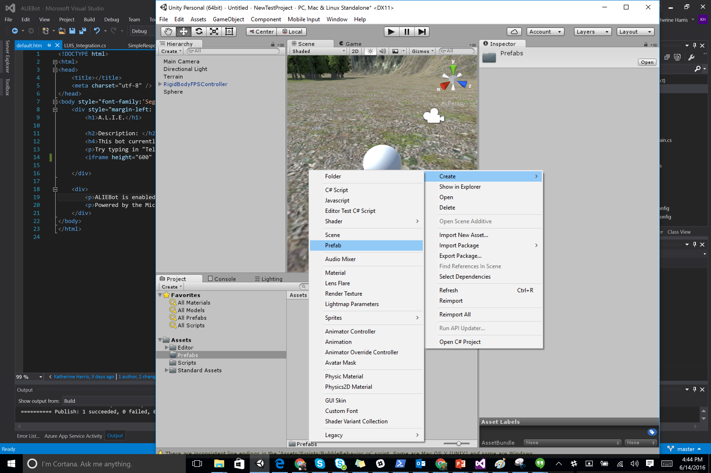
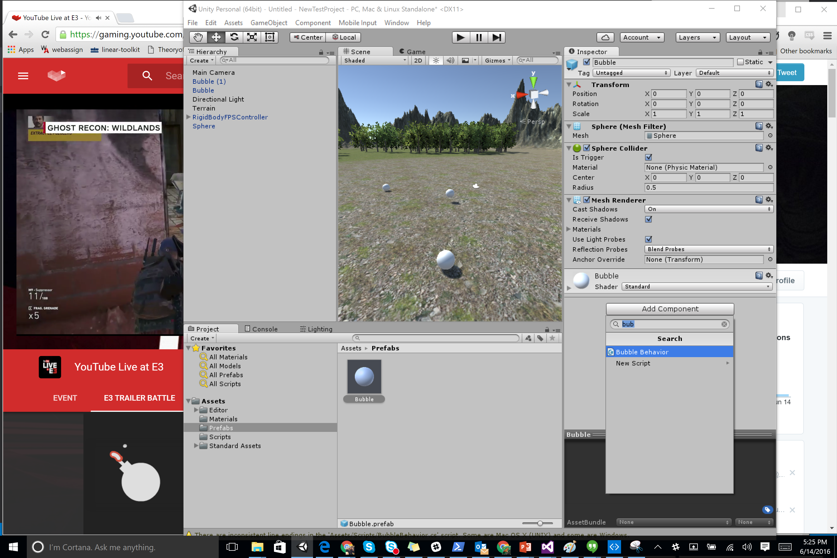

Slide 18
Create Prefab
Right Click in Project > Create > Prefab
Drag Sphere from Hierarchy to Prefab
Add Script to Prefab

Slide 19
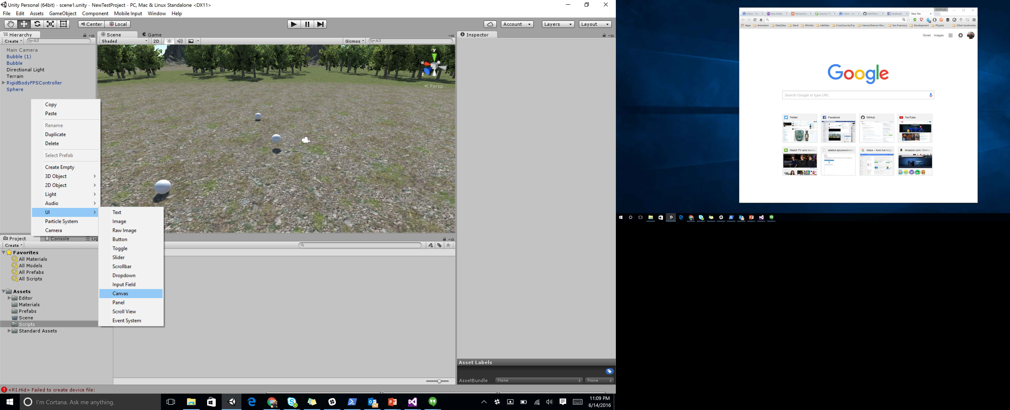
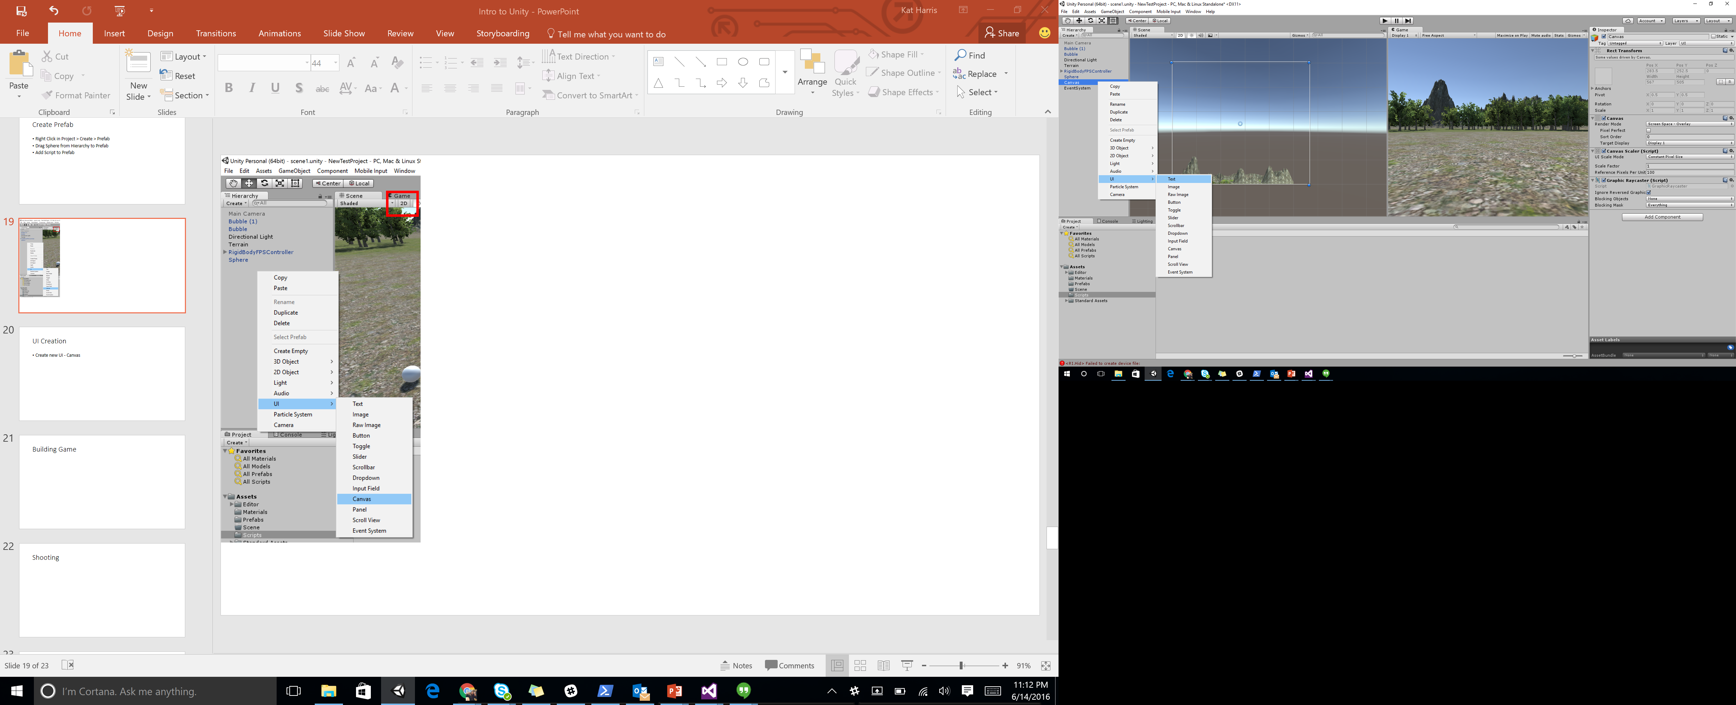

Slide 20
UI Creation
Right Click in Hierarchy > Create > UI > Canvas
With Canvas Selected – Right Click > Create> UI > Text
Change the TextBox Scirpt to “Score: “
Change the color to white
Change the Size to 35 and adjust the box in the Scene view

Slide 21
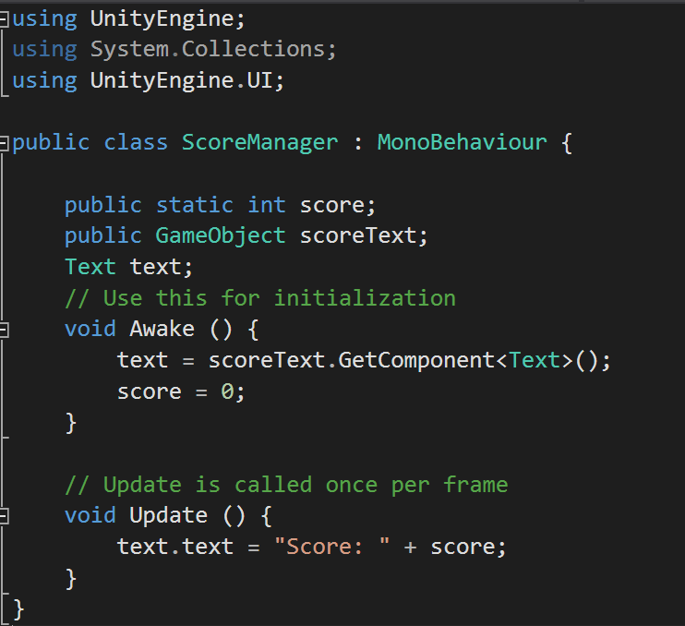
Adding Score Functionality
Right Click in the Scripts Folder in the Project Tab
Create > C# Script
Call it “Score Manager”
Add Code:

Slide 22
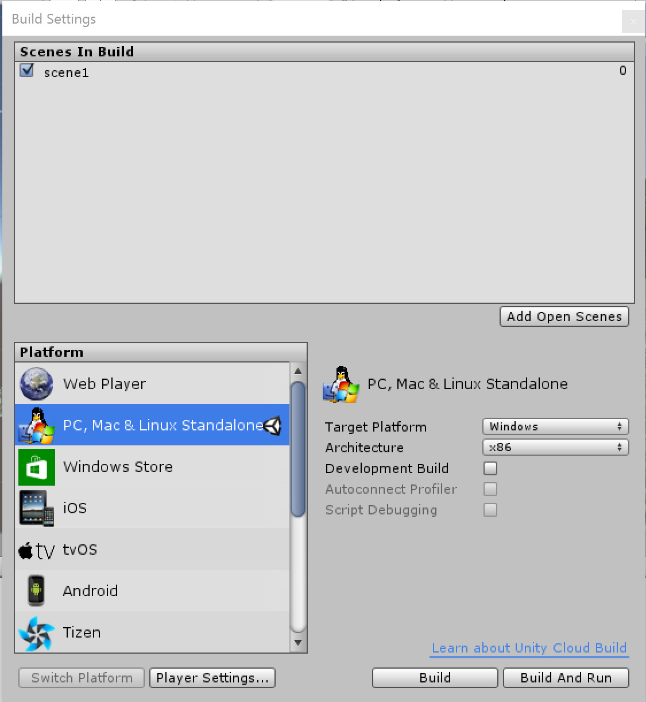
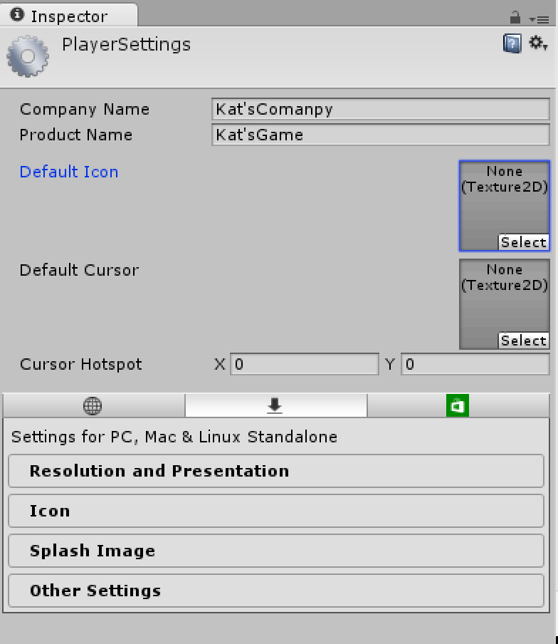

Slide 23
Building Game
File > Build Settings
Click Add Current Scene
Click Player Settings
Change the Company Name and the Product Name
Click Build and Run

Slide 24
Build Awesome Games!
Kat Harris
Email: Kaharri@Microsoft.com
Twitter: @KATVHARRIS
Resources:
https://github.com/KatVHarris/UnityIntro
https://KatVharris.azurewebsites.net

Slide 25
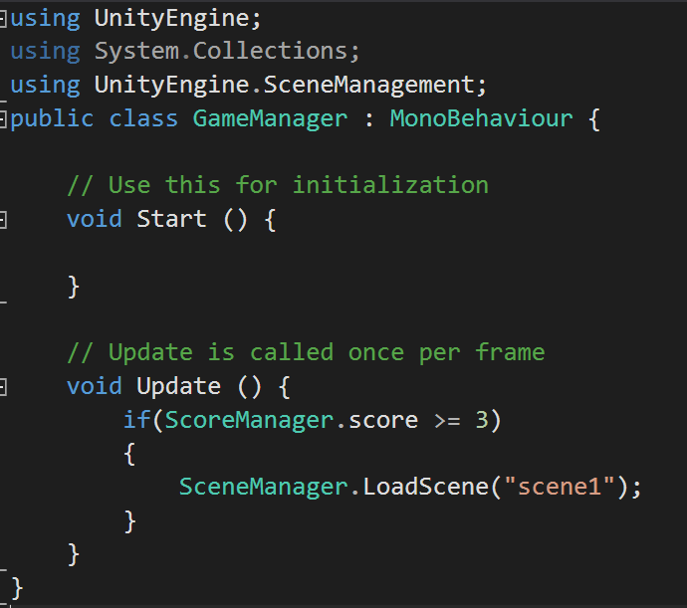
Restarting Level
In Scripts Folder RightClick Create > New Script > GameManager
Add Code:

Slide 26
Particle Effects

Slide 27
Shooting

